Slide 1


Slide 2
Session Agenda
Algorithm complexity
- Arrays
Hands on practice

Slide 3
Website for visualizing data structures
https://visualgo.net/en

Slide 4
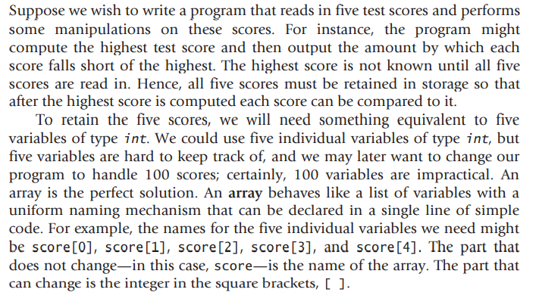
C++Arrays

Slide 5
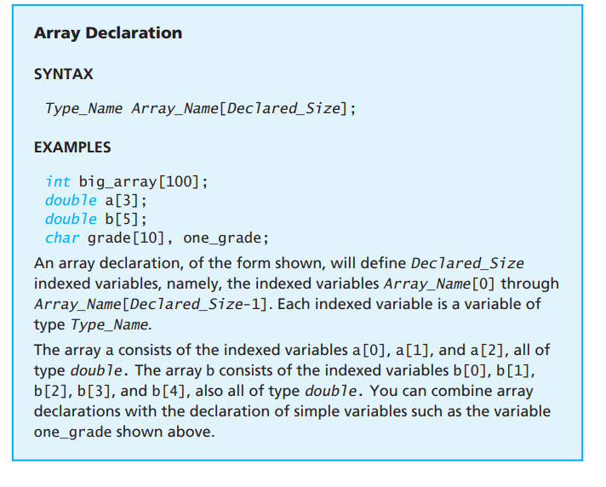
C++Arrays

Slide 6
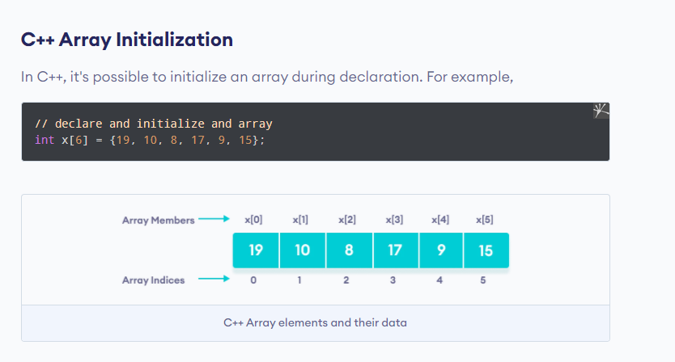
C++Arrays

Slide 7
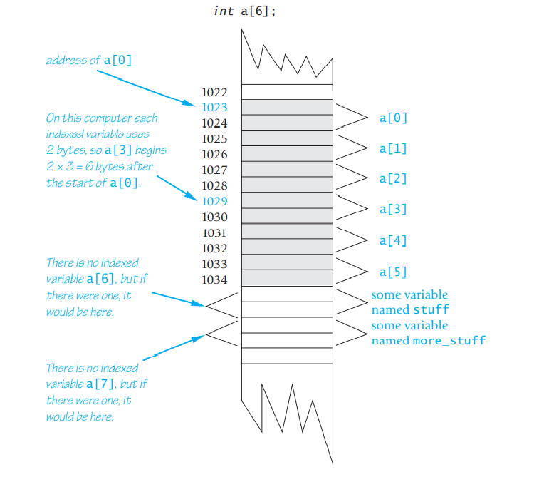
C++Arrays

Slide 8
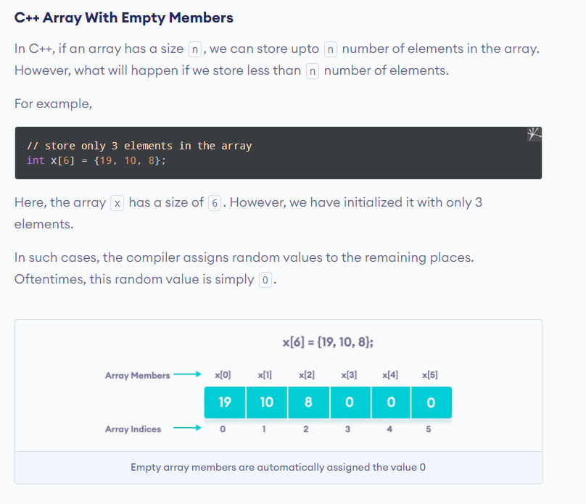
C++Arrays

Slide 9
C++Arrays

Slide 10
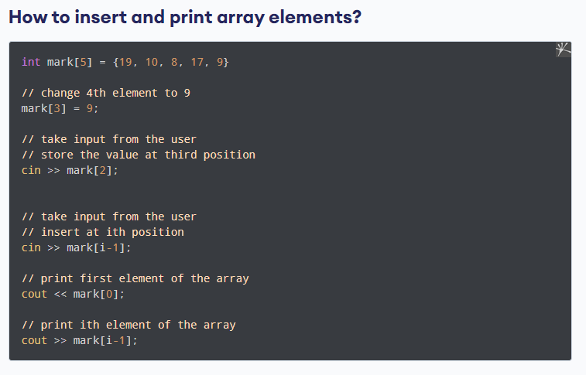
C++Arrays

Slide 11
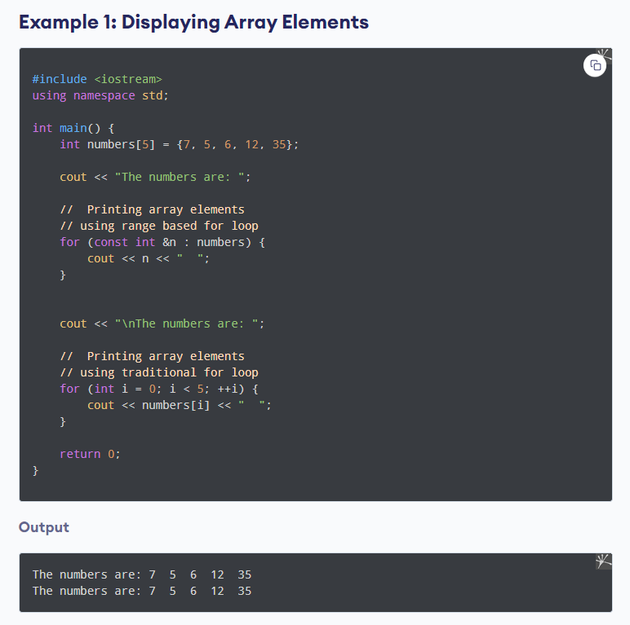
C++Arrays

Slide 12
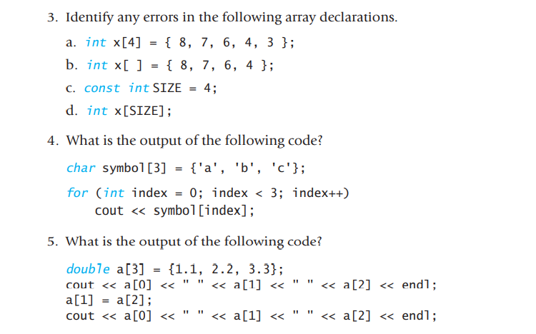
C++Arrays

Slide 13
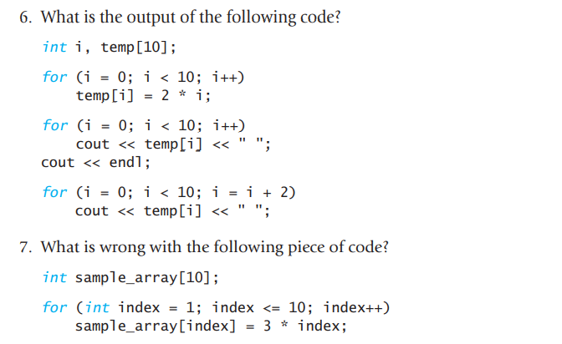
C++Arrays

Slide 14
C++Arrays
Given an integer array of size `n`, return the element which appears more than `n/2` times. Assume that the input always contain the majority element.
Input : [2, 8, 7, 2, 2, 5, 2, 3, 1, 2, 2]
Output: 2
Input : [1, 3, 1, 1]
Output: 1

Slide 15
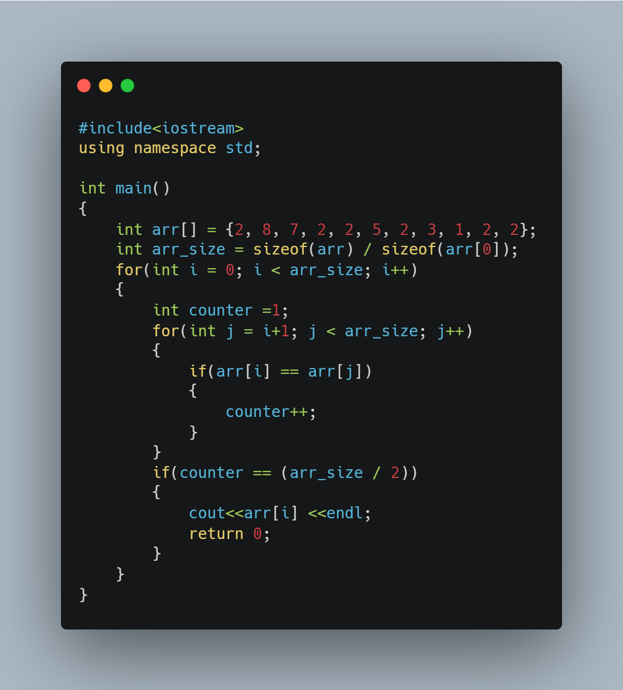

Slide 16
C++Arrays
Given an unsorted integer array, find a pair with the given sum in it.
• Example:
Input : nums[] = [8, 7, 2, 5, 3, 1], target = 10
Output: (8, 2) or (7, 3)

Slide 17
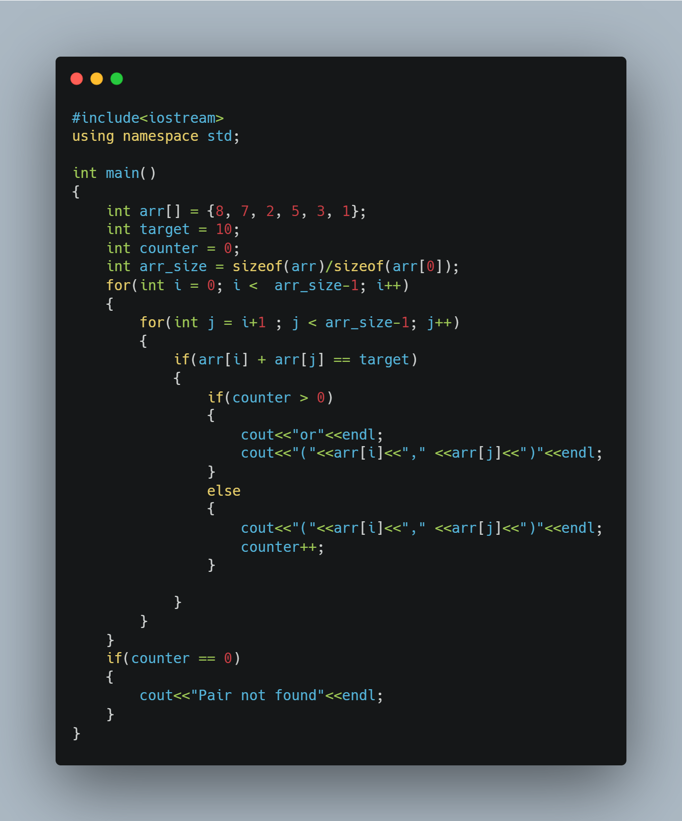

Slide 18
C++Arrays
Given an integer array, return all equilibrium index in it. For an array `A[0..n-1]`, index `i` is an equilibrium index if the sum of elements of subarray `A[0…i-1]` is equal to the sum of elements of subarray `A[i+1…n-1]`.
Input : [0, -3, 5, -4, -2, 3, 1, 0]
Output: {0, 3, 7}
Explanation: For each index `i` in the output, A[0] + A[1] + … + A[i-1] = A[i+1] + A[i+2] + … + A[n-1]
Input : [-7, 3, 7, -3, 1]
Output: {4}
Explanation: `n-1` is an equilibrium index if A[0] + A[1] + … + A[n-2] sums to 0.
Input : [1, 2, -4, 2]
Output: {0}
Explanation: 0 is an equilibrium index if A[1] + A[2] + … + A[n-1] sums to 0.

Slide 19
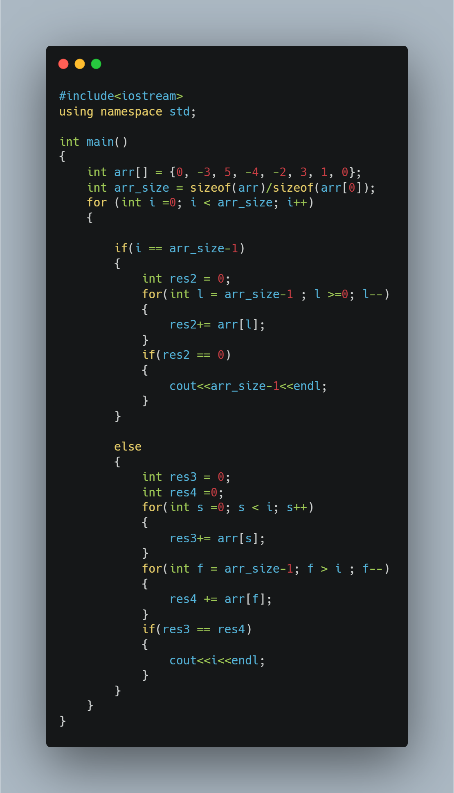

Slide 20
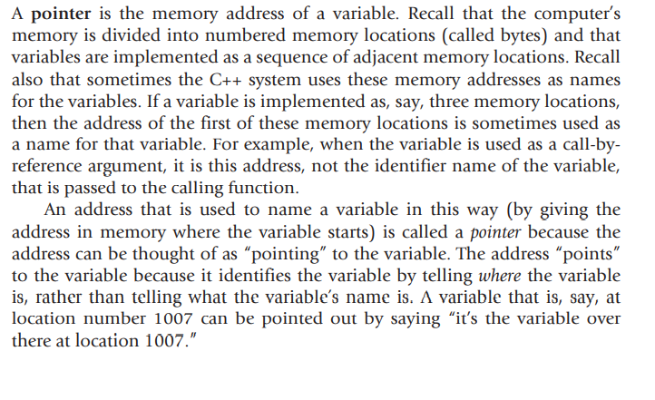
C++ Pointers

Slide 21
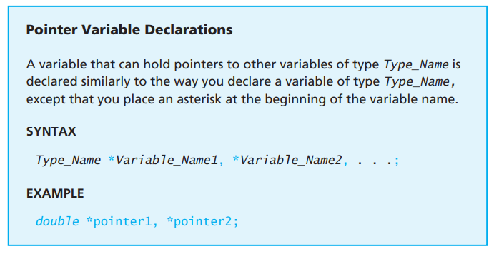
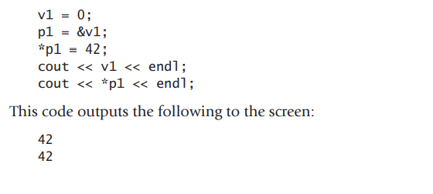
C++ Pointers

Slide 22
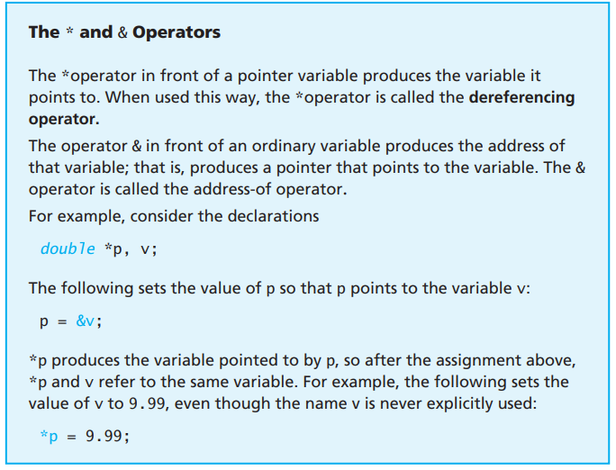
C++ Pointers

Slide 23
C++ Pointers

Slide 24
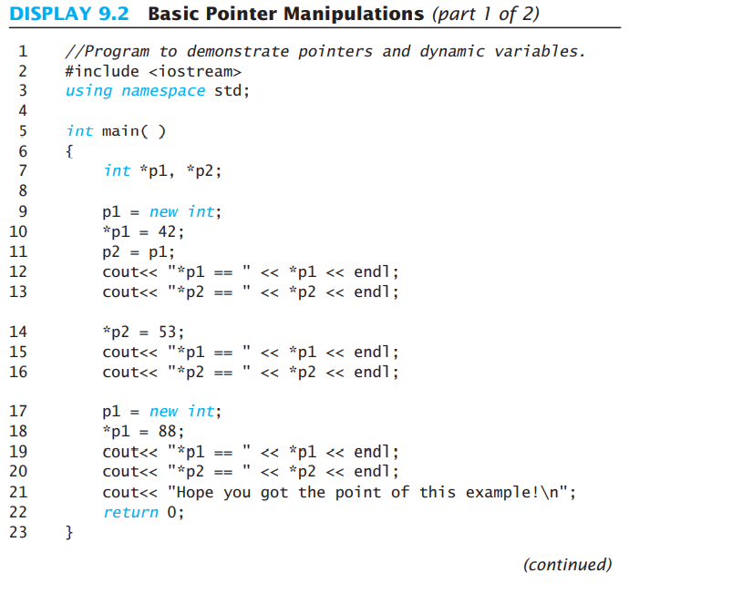
C++ Pointers

Slide 25
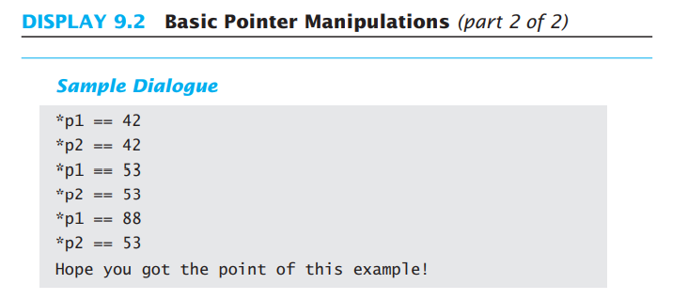
C++ Pointers

Slide 26
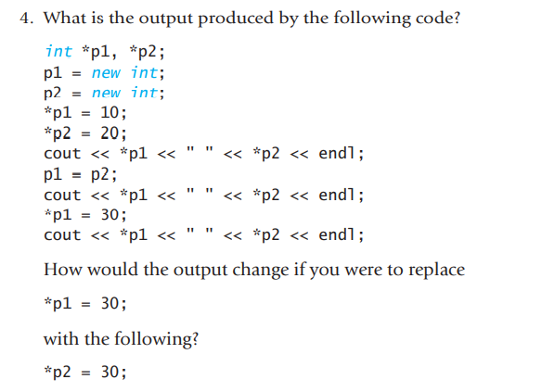
C++ Pointers

Slide 27
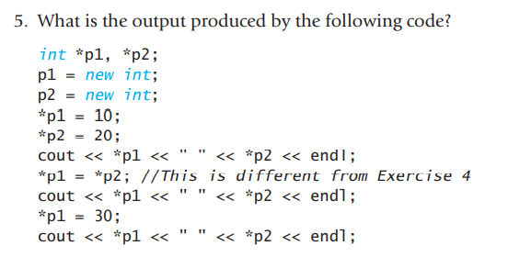
C++ Pointers

Slide 28
Sources
Books:
-Problem Solving with C++ ninth edition
Websites:
-Geeks for Geeks
-Tutorials point
-programiz
-w3schools
-cplusplus.com
- CodezClub
- HackerRank

